Slide 1
Intelligent Product Recommendation System for B2B Marketplace
Team Name: CodeStrom
Problem Statement ID: HACXPB001
Title: Qwipo: A Digital B2B Retail Web Application
Company: Qwipo(B2B Retail Marketplace)

Slide 2
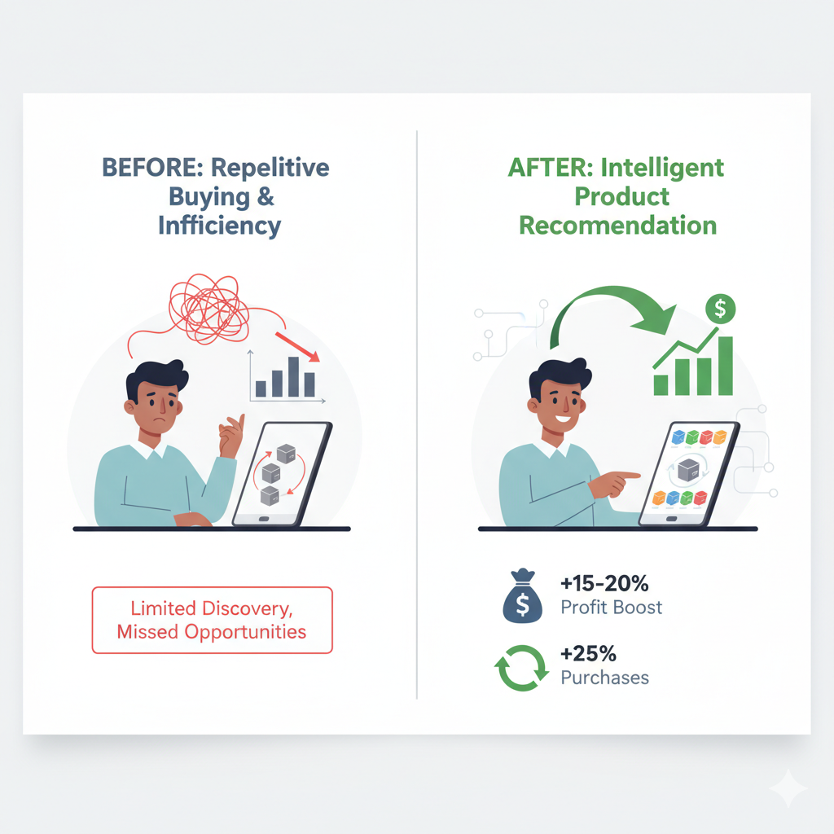
Problem Statement Reference
Problem Statement Chosen:
Problem: Retailers on Qwipo’s B2B marketplace struggle with product discovery and order optimization.
Current issues: Repetitive buying patterns and missed opportunities lead to lower profits and inefficient trade.
Reason to Choose the Problem Statement:
MSMEs rely on effective sourcing; solving this can:
Boost retailer profitability by 15–20%.
Increase repeat purchases by 25%.
Directly support small business growth.

Slide 3
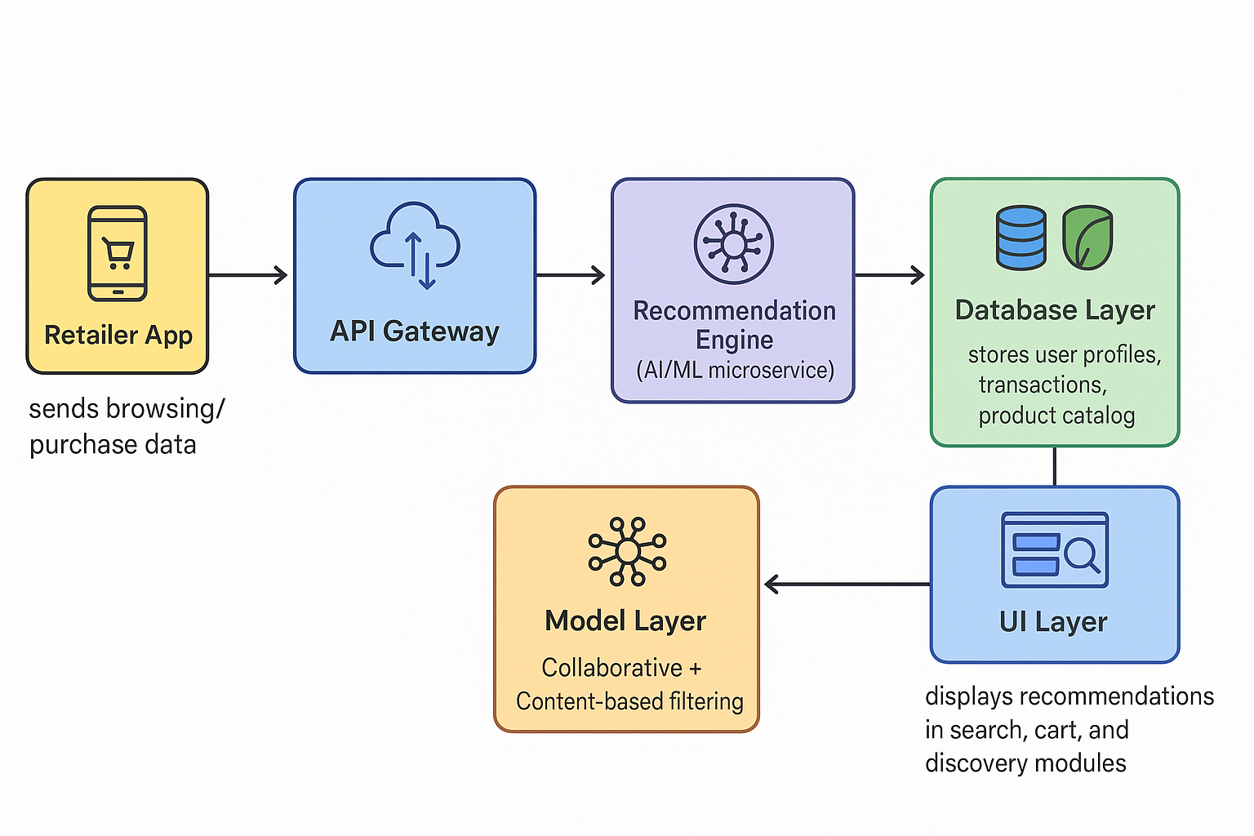
Solution Overview Proposed Approach
Solution:
AI-driven recommendation system analyzing retailer behavior to deliver personalized product suggestions within the mobile marketplace.
Key Features:
Personalized Recommendations – Based on history & peer activity.
Hyperlocal Trends – Top-selling products in the region.
Smart Cart – Bundles, alternatives, and margin insights.
Voice & Vernacular Search – Multi-language voice queries.
Seasonal Suggestions– Festival & seasonal relevance.
Retailer Circle & Reviews – Community-driven discovery.
Auto-Replenishment + Discovery Boost – Convenience + new products.
Gamified Rewards– Incentives for product trials.
Real-Time Dashboard– Insights for retailers & distributors.
Scalable API – <200ms response, 10,000+ profiles.
SystematicArchitecture:-

Slide 4
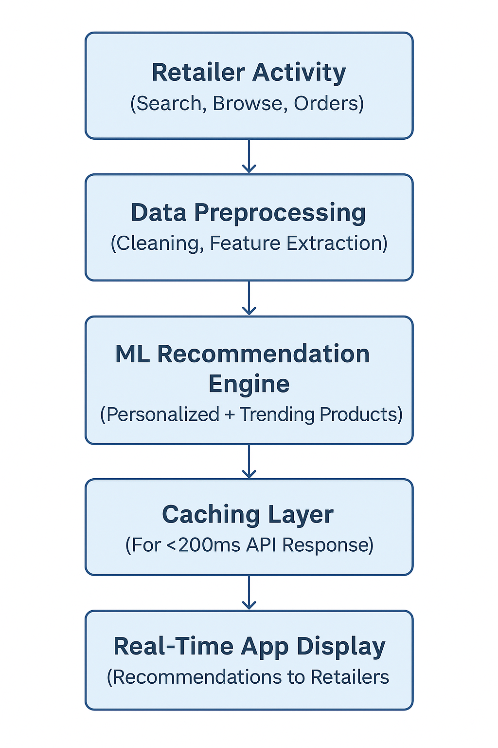
Data flow explination:
Retailer activity (search, browse, orders) is logged.
Data preprocessed (cleaning, feature extraction).
ML models generate recommendations (personalized + trending).
Results cached for faster API response (<200ms).
Recommendations displayed in real-time on the app.

Slide 5
Technology Stack
Algorithms & Models
Backend: Node.js with Express/Fastify, Python with Flask/FastAPI, Microservices.
Frontend: Mobile app (React Native/Flutter), Web interface (React.js).
Databases: PostgreSQL (structured), MongoDB (catalog & unstructured data).
ML/AI Frameworks: Python scikit-learn, TensorFlow, PyTorch.
APIs / Libraries: REST/GraphQL APIs, WebSocket (real-time), OpenAI/Gemini for NLP/semantic search
Algorithms Chosen:
Collaborative Filtering (similar retailers’ purchases)
Content-Based Filtering (product attributes, categories)
Hybrid Model (combination for accuracy)
Reason for Choice:
Hybrid systems combine strengths: collaborative filtering ensures personalization, content-based handles new products, and hybrid improves scalability.
Model Training & Testing Approach:
Data split into train/test (80/20).
Cross-validation for performance.
Evaluation on metrics like precision@k, recall@k, F1-score, and AUC.

Slide 6
Data Handling
Implementation Plan
Data Sources Used:
Transaction history, product catalog, retailer activity logs.
External APIs for trend/festival data (optional)
Preprocessing Methods:
Data cleaning (missing values, duplicates)
Feature engineering (purchase frequency, seasonality, language tokens)
Normalization for ML models
Storage / Pipeline Setup:
ETL pipeline for structured/unstructured data
Batch + real-time ingestion using Kafka/RabbitMQ
Storage in PostgreSQL (transactional) + MongoDB (catalog)
Initial Setup & Environment:
Configure backend servers, ML environment, and databases.
Core Module Development:
Build recommendation engine with collaborative + content-based filtering.
Integration & Testing:
Integrate with mobile app APIs, run A/B testing for recommendations.
Final Deployment-ready Build:
Optimize response times, deploy microservices with load balancing.

Slide 7
Performance & Validation
Deployment & Scalability
Validation:
ESLint is set up for code linting (eslint scripts and config).
TypeScript type checking is enabled (typecheck script).
Form state and input handling are present (e.g., in
AutoReplenishment.tsx), but there is no evidence of advanced form validation libraries (like Yup or Joi).
Performance:
Vite is used for fast builds and hot module replacement.
There are optimizations in vite.config.ts (optimizeDeps).
Some UI components mention optimization (e.g., “Mobile optimized” in ARShelfPreview.tsx, “Optimize your purchases” in SmartCart.tsx).
No automated performance reporting tools (like Lighthouse) are found in the codebase.
Deployment Plan:
Containerized microservices (Docker, Kubernetes).
Cloud deployment (AWS/GCP/Azure).
Continuous Integration/Deployment (CI/CD).
Scalability Consideration:
Horizontal scaling to support 1,000+ concurrent users (Phase 3).
Auto-scaling ML inference services.
Caching (Redis) for <200ms latency.

Slide 8
Thank You...

